Slide 1
Big Data viewed from a Statistics Office
8 May 2015
Deputy director Regions and Environment SCB
Adjunct Professor KTH
Viveka Palm

Slide 2
Big Data as a source for official statistics
Statistics traditional sources: surveys or registers make up a data set that is voluminous and verifiable; Built for showing time-series, harmonized, stable.
Not renewed in the velocity and detail that we think of as ‘big data’.
Potential of combining these data sources:
for new statistics, e.g. transportation patterns and urban planning statistics
for support in regular statistics to decrease the need for surveying.
Methodological, technical, management and privacy issues have to be considered.
Notes:
The four V:s of big data
(Volume, Variety, Velocity and Veracity.)

Slide 3
Uses at Statistics Sweden
Cooperation within the government: Cooperative uses of geographical data leads to better quality and possibilities for new categories and more detail. For example green areas in cities. Sensor data analysis in order to produce new statistics of use for urban planning.
Data from private holders: credit card registers, scanner data, electricity consumption. To replace survey data, inform models or create new types of statistics.

Slide 4
Strategic innovation agenda for big data analytics
prepared for Vinnova, Formas, Energy Agency.
SCB together with a consortium of companies, universities and governmental organizations.
The agenda, in English: http://www.vinnova.se/PageFiles/0/Big%20Data%20Analytics.pdf

Slide 5
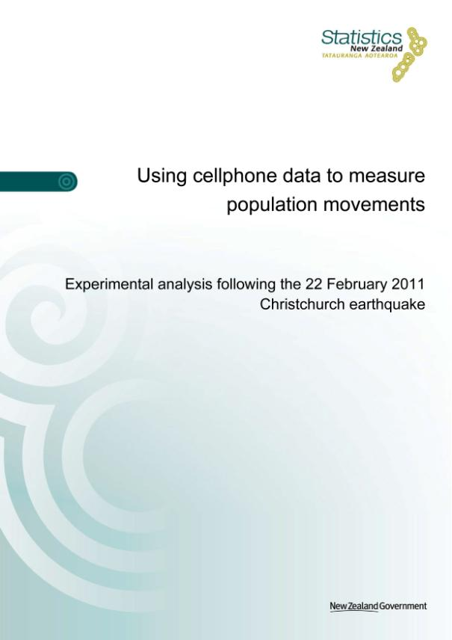
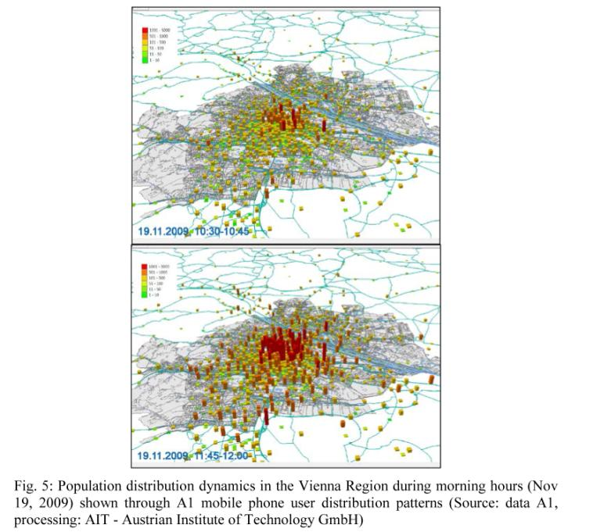
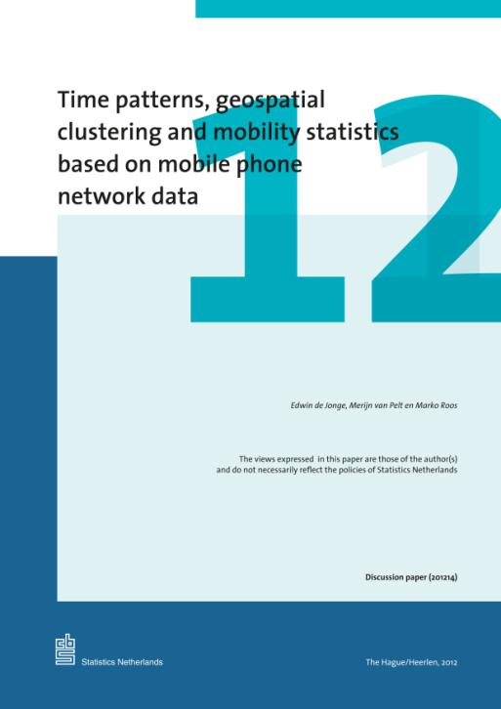
http://www.cbs.nl/nl-NL/menu/themas/bedrijven/publicaties/digitale-economie/methoden/time-patterns-geospatial-clustering-and-mobility-statistics.htm
http://www.stats.govt.nz/tools_and_services/services/earthquake-info-portal/using-cellphone-data-report.aspx
http://www.researchgate.net/publication/231473875_Mobile_phone_data_as_source_to_discover_spatial_activity_and_motion_patterns

Slide 6
Development of geoanalytics
Most registers have geographic references (coordinates, addresses, etc.).
Inspire cooperation increases the possibilities to combine register data with geodata.
For example: find the population that lives in danger of flooding, map vulnerable water areas with waste treatment facilities and transport of dangerous goods.
Need for methods and new thinking to use the data effectively and realise the potential.

Slide 7
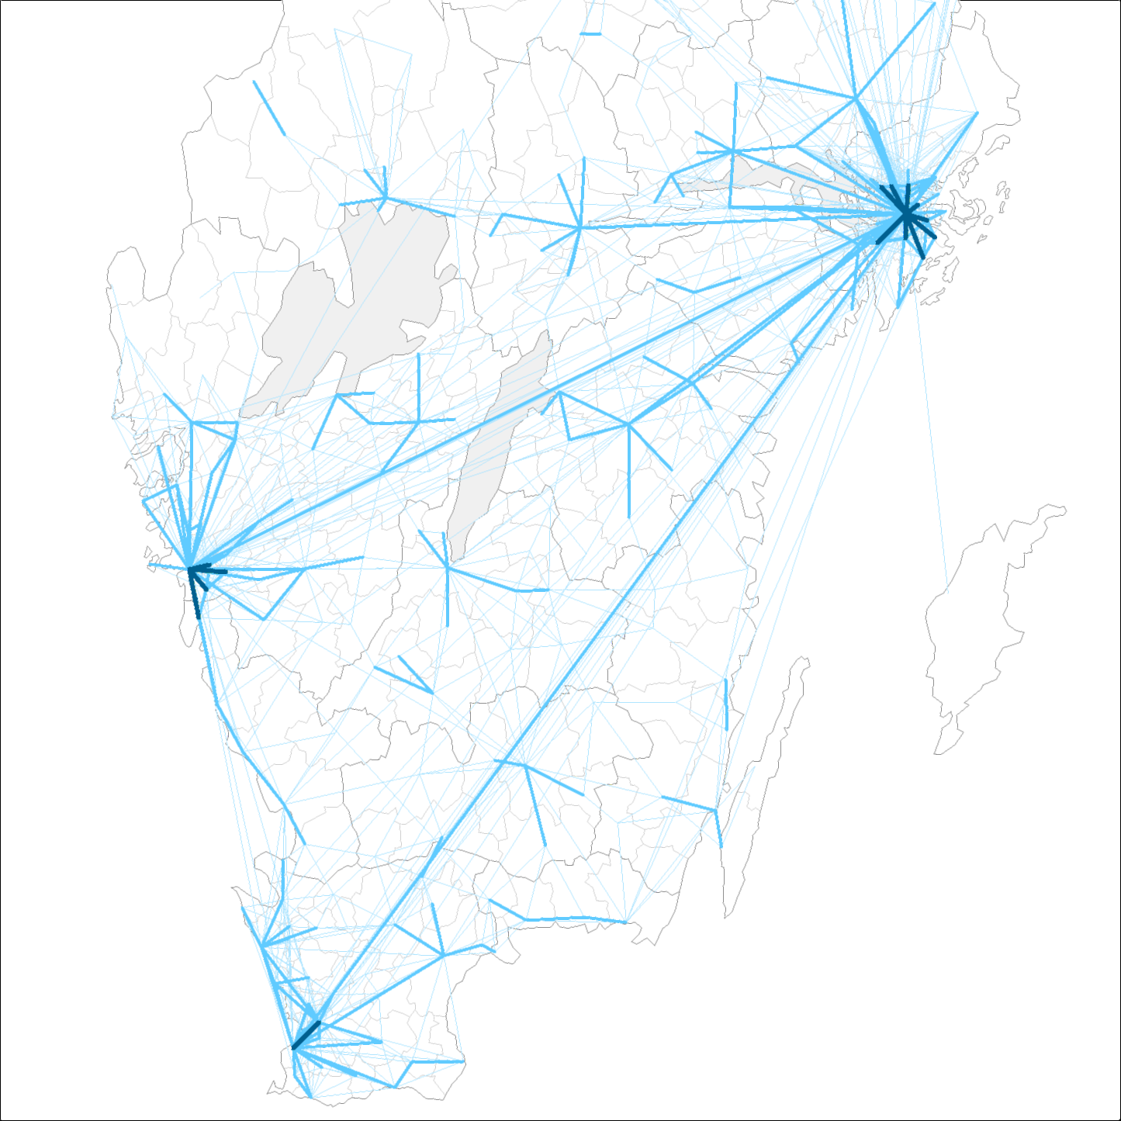
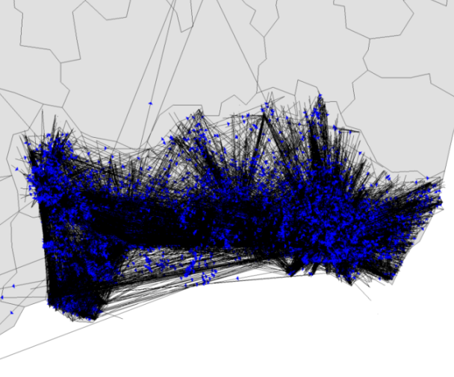
The step from data to information – example mobility
Data is rich – how to realise the information potential?

Slide 8
Challenges for official statistics
UNECE: “What does “Big Data” mean for official statistics?” Conference of European Statisticians
  Legislative
  Privacy
  Financial
  Management
  Methodological
  Technological
Other criteria of quality for official statistics, i.e. Code of Practice

Slide 9
Challenges, cont.
“The real challenge lies in the methodology to transform the raw internet data into representative and quality statistics” (Heerschap 2013)
What does Big Data mean for…
  Representativeness of data, inference, estimation, bias, etc.
  Metadata, descriptions of processes and variables, classification, transparency and traceability
  Stability over time
  Noise
  Objectivity and trust

Slide 10
What next?
Need for new analytic tools: Research questions to be explored in broader cooperation with many actors in society.
Many methodological problems to be solved
Case studies important
New skills needed
Cooperation: nationally, Nordic, EU, UNECE, universities

Slide 11

Thanks for listening!

