Slide 1

Viva la revolución?
Harnessing the Data Revolution
for Good
Eva.Jespersen@undp.org, @undphdr, May 2015 Human Development Report Office

Slide 2
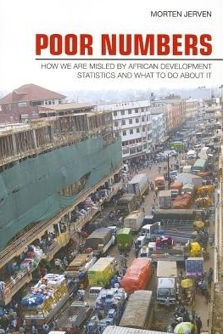
‘Houston [HQ] we have a problem’
About half of children sub-Saharan Africa are not registered at birth: lack of infrastructure
Low capacity to produce, coordinate and communicate official statistics; (census, administrative, surveys)
Country MDG data annually, but much is extrapolated
Data Deluge or data drought ?

Slide 3

Increased Demands
Gaps remain in monitoring 8 MDG using official statistics
More gaps to come with data-ambitious (17) SDGs (169 targets w 2 indicators each)
More humanitarian and local govt demands
Increased citizens demand for information to hold authorities accountable
Could The Data Revolution solve some of these problems …

Slide 4

A Wealth of New Data
ICT is fueling a new world of data
often people-generated transactional data (mobile phones, credit card, social networks)
… and privately-owned
‘big data’ (primary data of great volume, velocity, variety)
“Getting information off the Internet is like taking a drink from a fire hydrant.”
Mitchell Kapor

Slide 5

More Data: More Possibilities
Massive samples offer extremely fine granularity (many are too small)
A window into how people behave (not how they report they behave)
Data available in real time (nowcasting)
Potential for real-time policy making
Humanitarian benefits too e.g Facebook Safety Check in Nepal
Considerable Strengths

Slide 6
SoMe, Mobile NW & IoT
Mobile NWs are enabling:
Communication between people (voice, SMS, MMS, email, …)
Web access: media, data and information, art works, …, YNI
Sharing and publishing in the Web
Communication between machines (IoT)
IoT can produce (erraneous) sensor data about … YNI
SoMe can produce human interpreted (mis)information about … YNI
NW operators should enable networking and protect subscriber privacy:
Foolproof anonymization is a very difficult task.
Cross tabulation of data from several sources can reveal a lot of unintended information about the individual subject.
Thanks to Kimmo Hätönen, Nokia, Helsinki
YNI – You Name It!
Source criticism!

Slide 7

More tools
Mobile data helped report 18 million births in Nigeria in 2011-12
SMS surveys helped reduce malaria medicine stock-outs:80% in Uganda
Google search data may predict everything from recessions to flu epidemics

Slide 8
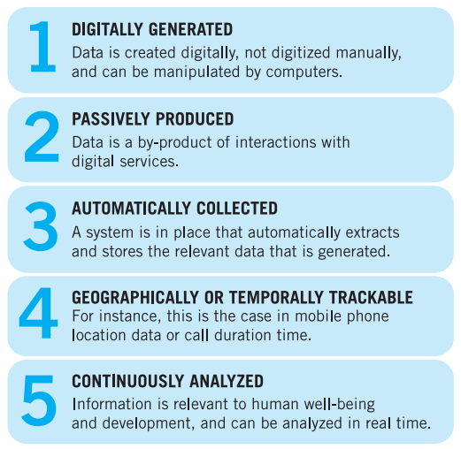
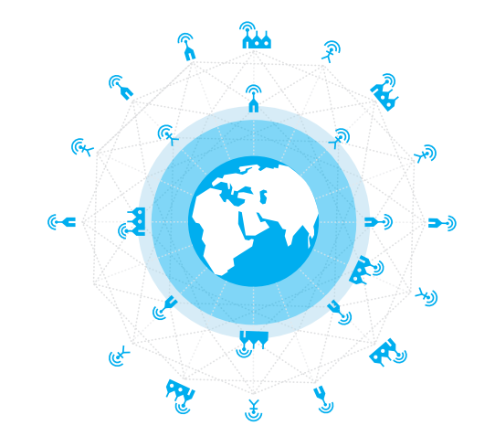
Data Revolution +

Slide 9

Wider Community
Statisticians tend to be cautiously optimistic
Questions on integrating new data w old statistical system
Private providers, some international, do new analysis, increase demands for quality; raise some concerns on ethics
Tensions between NSOs and new data providers, especially when NSOs receive no credit

Slide 10
Data Revolution +/-
Big Data sets are massive but can be
massively biased (selection bias etc.)
massively hard to manage or analyse, and store.
Big data can create big distractions: managing a world of information overload?
Stats development and analysis requires also new techniques, equipment, and legislation etc: resources and capacity
Visible weaknesses

Slide 11


Data Revolution - areas for development
Protecting privacy & ensuring data are used only for good
Attention to sources and provenance
Addressing tensions between NSOs and big data users & providers (Tanzania)
Developing new collaboration (e.g. DANE Colombia)
Data rich or data poor: breaking a worsening inequality of information

Slide 12

Global Cooperation

Slide 13
(IEAG) Data Revolution for Sustainable Development
The integration of new data with traditional data for more quality, detailed, timely and relevant information;
Greater openness and transparency, without invasion of privacy and abuse of human rights
Minimising inequality in production, access to and use of data;
More empowered people, better policies, and decisions, participation and accountability

Slide 14
A world that counts leaves nobody behind
Build data, capacity and statistical literacy
Communicate / vizualise data
Regulate for privacy and data rights
Strengthen independence and trust in NSOs that can stay relevant in a changing world
Bringing public and private providers regularly together (‘World Forum on Data’)
Public data should be ‘open by default’

Slide 15
hdr.undp.org is always on
HDialogue; Global, Regional and National Reports; occasional papers, events and other HD relevant materials
HD data bases and visuals
Like HDR on facebook; follow us on twitter
Thank you

